Slide 1
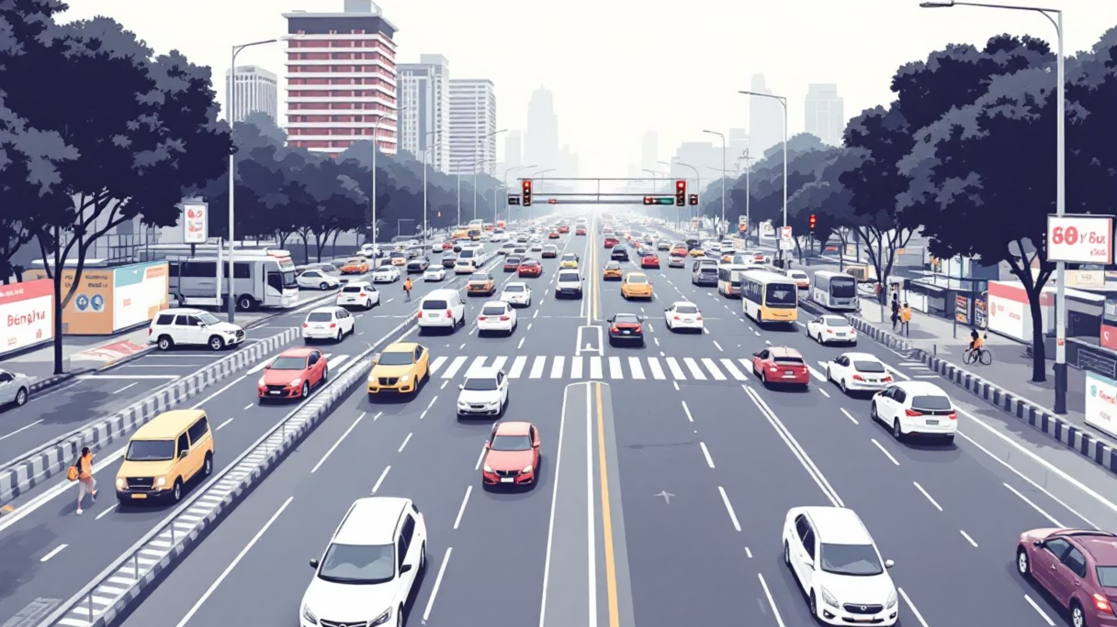
Traffic Flow Optimization Using Machine Learning (LSTM & XGBoost)
Predicting traffic congestion levels in Bengaluru city using real-time traffic parameters

Slide 2

Project Overview
Traffic Congestion Prediction
Aim
Purpose:
To predict traffic congestion levels in Bengaluru city using real-time traffic parameters.
Help city planners & commuters predict congestion ahead of time
Built two models:
Enable dynamic traffic signal control and route optimization
LSTM (Long Short Term Memory) for temporal sequence analysis
Outcome:
XGBoost (Extreme Gradient Boost) for tabular data with engineered features
Achieved high prediction accuracy and actionable insights into congestion patterns.

Slide 3


Bengaluru Traffic Dataset Overview
Source & Scale
Preprocessing Steps:
Source: Publicly available dataset of traffic data from Bengaluru roads
Handled missing values
Records: ~9,000 samples
Extracted time-based features (hour, day, month, etc.)
Key Features:
Encoded categorical features (Weather)
Created lag & rolling features for trend detection
Date & Time
Average Speed (km/h)
Traffic Volume
Congestion Level
Travel Time Index
Road Capacity Utilization
Incident Reports
Weather Conditions

Slide 4

About LSTM (Long Short-Term Memory Networks)
LSTM is a type of Recurrent Neural Network (RNN) specialized for sequential time-series data.
Why LSTM?
Captures temporal dependencies (previous traffic states affect future states).
Handles long-term patterns like peak-hour trends.
Works well when congestion depends on time-based events (rush hours, weekends).
Structure:
Input layer → LSTM layers → Dense output
Uses memory cells to remember long-term dependencies

Slide 5
LSTM Model Implementation & Performance
01
02
03
Data Preparation
Model Architecture
Training
Data scaled and reshaped to 3D (samples × timesteps × features).
Model built with 2 LSTM layers + Dense output.
Trained using Adam optimizer and MSE loss.
Results:
566.009
23.790
20.418
36.90%
MSE
RMSE
MAE
MAPE
-0.0287
R²
Inference:
Model learned short-term patterns well
However, struggled to generalize (negative R²) → possible underfitting or scaling issue

Slide 6
XGBoost: Gradient Boosting for Tabular Prediction
XGBoost stands for Extreme Gradient Boosting.
Why XGBoost?
Feature Engineering:
Handles non-linear relationships effectively.
Added lag & rolling mean features (traffic trends).
Robust to missing values & outliers.
Time features (hour, day, month, weekend).
Uses feature importance for explainability.
Encoded weather and incidents.
Faster training compared to deep learning.

Slide 7



XGBoost Implementation & Comparative Results
Feature Engineering
Training Setup
Implementation
Used engineered tabular features.
Trained with 500 boosting rounds, early stopping, and RMSE evaluation.
Used xgb.train() for advanced control.
Results:
0.2760
0.5254
0.2621
0.50%
MSE
RMSE
MAE
MAPE
0.9995
R²

Slide 8
Inference:
Excellent generalization and near-perfect fit.
Outperformed LSTM in proportional accuracy and R².
Indicates XGBoost captures engineered temporal features better.
Conclusion and Future Scope
Conclusion:
Future Work:
XGBoost performed better in accuracy and interpretability.
Combine both models (Hybrid Ensemble).
Integrate with real-time data for live congestion dashboards.
LSTM performance could improve with scaling & tuning.
Deploy using Streamlit or Flask web interface.

